Slide 1
Optimizing Supply Chain Efficiency using data analytics & ai For a Beauty startup
Presented by
Team 10
Notes:
Give Introduction on Supply chain :

Slide 2
Agenda
Business Challenges and Impacts
Industry Trends and Data Sources
Challenge Identification with AI & Analytics Solution
Key Takeaways
Introduction
Methodology
Proposed Solutions
AI Models and Techniques
Conclusion

Slide 3
Introduction
Context: In today’s fast-evolving supply chain environment, businesses face challenges like shipment delays, inventory mismanagement, and rising transportation costs. These challenges directly impact customer satisfaction, operational efficiency, and business profitability.
Objective: This project aims to optimize supply chain operations by leveraging data analytics, AI-driven models, and predictive analysis to address key business issues such as:
Reducing shipment delays
Resolving inventory mismanagement
Minimizing transportation costs
Approach: We utilized machine learning models, including Random Forest Regressor, Logistic Regression, and KMeans Clustering, alongside Tableau visualizations to provide actionable insights.

Slide 4
Business challenges & impacts
1. Shipment Delays:
How can we address shipment delays in specific regions that impact delivery timelines?
2. Inventory Mismanagement:
What strategies can help resolve inventory mismanagement to avoid overstock or stockouts?
3. Rising Transportation Costs:
How can we reduce rising transportation costs to minimize operational expenses?
Impact of Inefficiencies:
Increased operational costs
Reduced customer satisfaction
Negative effect on profitability
Notes:
Business Problem
“Supply chains often face challenges like delays in shipments, poor inventory management, high transportation costs, and quality issues. These problems make it hard for businesses to operate smoothly and deliver products on time.”
Impact of Inefficiencies
“These inefficiencies lead to higher costs for the company and unhappy customers, who may stop trusting the brand. In the long run, this can reduce profits and hurt the overall growth of the business.
Our objective is to address these issues using data, AI, and analytics to create more efficient and predictive supply chain solutions.”

Slide 5

Industry Trends and Data Sources
Industry Trends : Growing adoption of AI and analytics in supply chain management for predictive capabilities.
Focus on reducing costs and improving quality control.
Data Source :
Collected from a Fashion and Beauty startup. The dataset is based on the supply chain of Makeup products.
Dataset Features : Supplier Name, Cost, lead times, defect rates, transportation modes etc..
Notes:
AI and analytics are becoming essential in supply chain management, allowing businesses to predict potential delays and optimize operations. Companies are focusing more on using these tools to reduce costs, streamline processes, and maintain better quality control. . This dataset we collected from a Fashion and Beauty startup. The dataset is based on the supply chain of Makeup products. Some of the features in the dataset: Our analysis shows that integrating AI and analytics into supply chains can significantly boost efficiency, reduce delays, and improve customer satisfaction, making them powerful tools for modern supply chain management.”

Slide 6
Methodology
Data Collection:
Gathered supply chain data related to lead times, transportation costs, stock levels, and shipment delays from public datasets.
Data Preprocessing:
Cleaned, processed, and normalized the dataset by handling missing values, removing duplicates, and scaling numerical features.
Feature Engineering:
Created new features like Delay Risk Score, combining lead times, defect rates, and transportation costs for better prediction accuracy.
Model Development:
Applied machine learning models such as Random Forest Regressor, Logistic Regression, and KMeans Clustering for predictions, cost analysis, and inventory classification.
Model Evaluation:
Evaluated models using key performance metrics like Mean Squared Error (MSE), Accuracy, R² Score, and Silhouette Score to ensure accuracy and reliability.
Data Visualization and Recommendations:
Exported model results to Tableau for visualization and generated insights for actionable business recommendations.
Notes:
We started with data preprocessing and exploratory analysis to clean and prepare the dataset for modeling. Key features such as lead times, defect rates, and costs were normalized using the MinMaxScaler for consistency. Through visualizations, we identified key trends and correlations that guided the next steps of the project.

Slide 7
AI Models and Techniques
Random Forest Regressor
Used for predicting lead times based on shipment type, transportation method, and historical delays.
Key Metric: R² Score (0.91) and MSE (1.8 days²).
Logistic Regression
Applied for classifying shipments as "High Cost" or "Low Cost" based on transportation type and delay risk.
Key Metric: Accuracy (86%) and F1 Score (0.835).
KMeans Clustering:
Performed inventory clustering based on stock levels, defect rates, and revenue generated.
Key Metric: Silhouette Score (0.65) and WCSS (4,567).
Decision-Making Algorithm (Integrated Model):
Combined Delay Risk and Cost Models to recommend the best transportation method for each region, ensuring cost-effectiveness and timely deliveries.

Slide 8
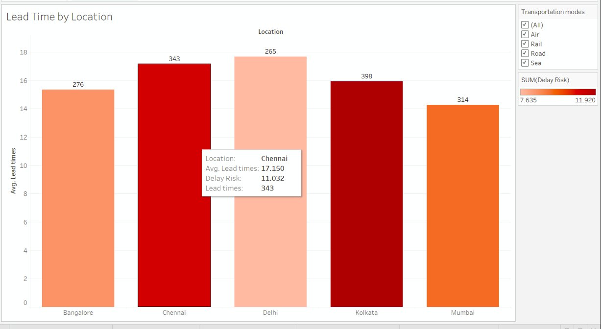
KEY CHALLENGE 1 : Shipment Delays in Specific Regions Impacting Delivery Timelines
Analytics solution and Insights
Notes:
The primary challenge identified was shipment delays in specific regions, significantly impacting delivery timelines. This bar chart highlights lead time and delay risk by location, emphasizing areas like Chennai with high delays. This analysis allowed us to focus on optimizing transportation modes for these regions

Slide 9
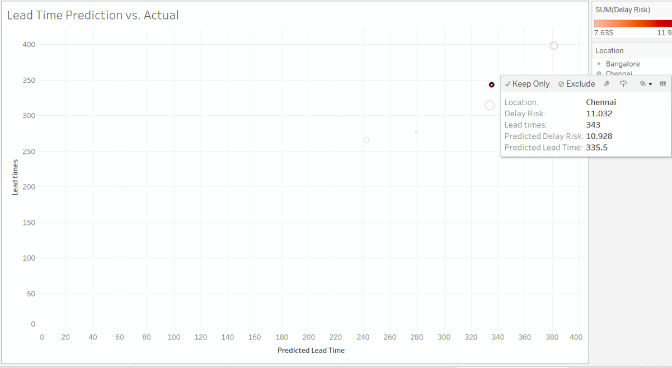
Solution
This scatter plot validates the accuracy of the lead time prediction model by comparing predicted lead times against actual lead times.
It emphasizes the model’s ability to forecast delays and enable proactive interventions.
Notes:
The scatter plot validates our lead time prediction model by comparing actual vs. predicted lead times. The close alignment between these values demonstrates the model’s accuracy in forecasting delays, enabling proactive interventions to improve supply chain efficiency.

Slide 10
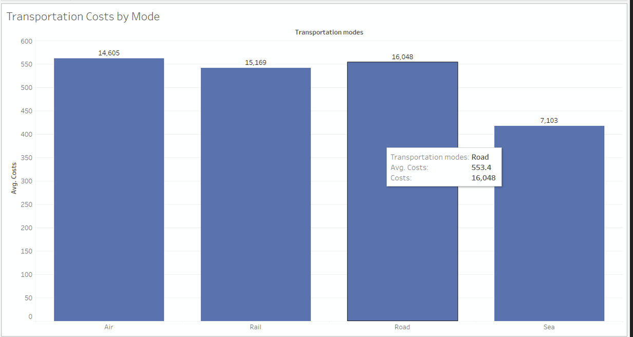
KEY CHALLENGE 2 :Rising Transportation Costs Adding to Operational Expenses
Analytics solution and Insights
Notes:
Another major challenge: increasing transportation costs, which are significantly adding to operational expenses. The bar chart compares average costs across transportation modes, showing that road transport incurs the highest costs, while sea transport is the most cost-effective option

Slide 11
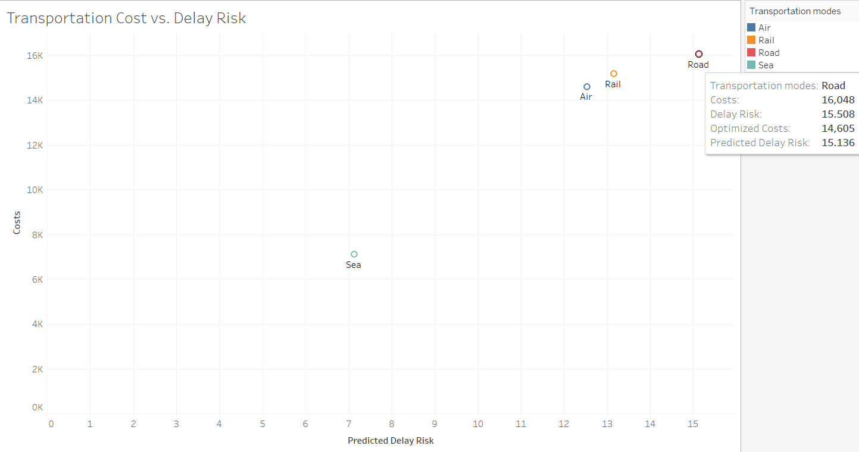
Solution
This scatter plot analyzes the relationship between transportation costs and delay risks for each mode.
It shows that sea transport is cost-effective and has low delay risks, making it a viable option for non-time-sensitive goods.
Notes:
This scatter plot illustrates the relationship between transportation costs and delay risks for various modes. It reveals that sea transport is both cost-effective and has lower delay risks compared to road and air. This insight is crucial for optimizing non-time-sensitive shipments.

Slide 12
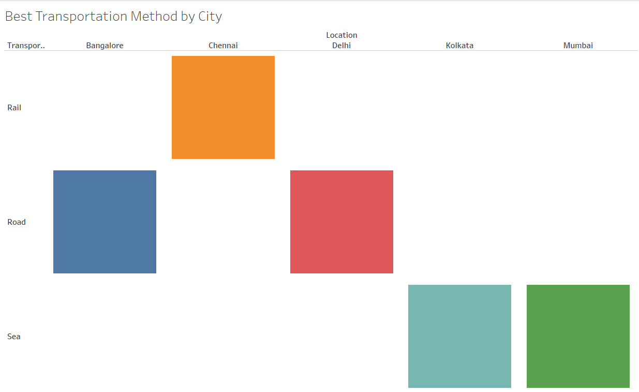
Solution
The best transportation method for each city based on delay risks and Costs.
Notes:
This chart summarizes the best transportation mode for each city, considering delay risks and costs. It provides actionable insights by identifying the optimal mode for each location, helping to balance cost and reliability for effective supply chain operation

Slide 13
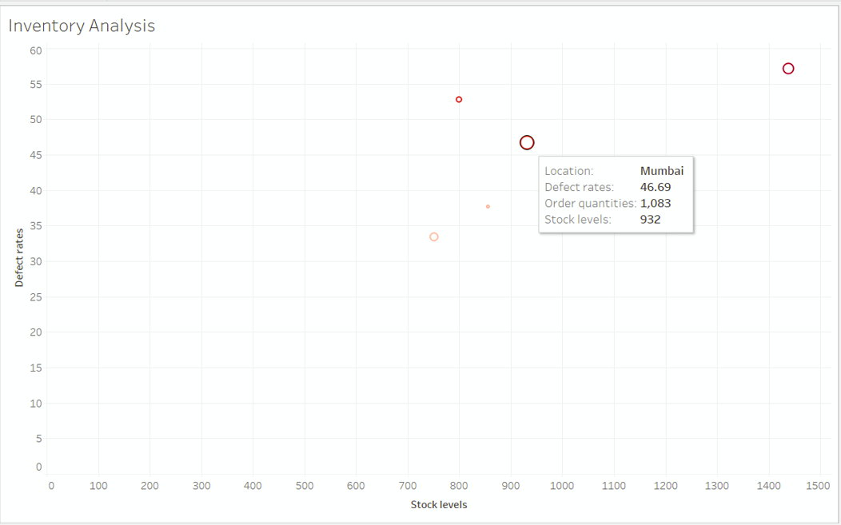
KEY CHALLENGE 3: Inventory Mismanagement Causing Overstock or Stockouts
Analytics solution and Insights
Notes:
Another challenge is inventory mismanagement, which leads to overstock or stockouts. The scatter plot highlights locations like Mumbai, where high defect rates and stock levels contribute to inefficiencies. This visualization helps identify imbalances in inventory management across locations.

Slide 14
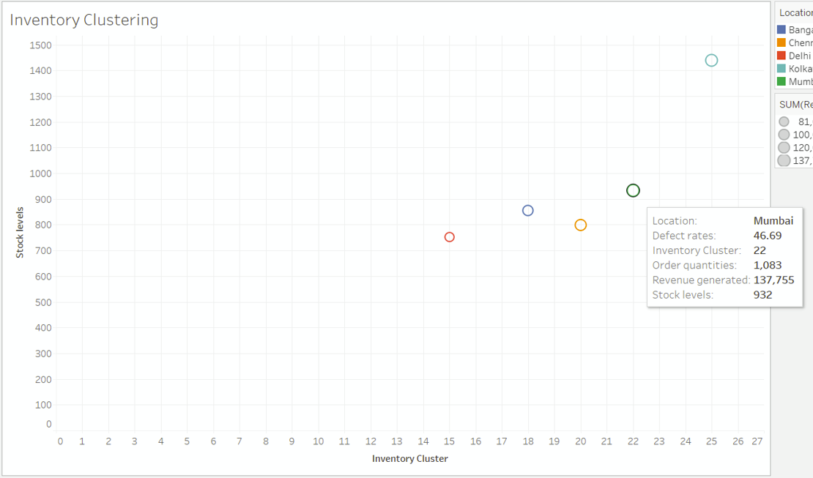
solution
The clustering visualization segments locations into clusters based on stock levels, defect rates, and revenue generation
It provides actionable insights for tailored inventory management strategies.
Notes:
The clustering visualization groups locations based on stock levels, defect rates, and revenue generation. It segments regions into actionable clusters, helping us tailor inventory management strategies to balance supply and demand while minimizing costs and risks

Slide 15
Proposed Solutions
1. Shipment Delays:
Use rail transport for high-delay regions (Chennai, Bangalore).
Optimize routes and improve logistics planning.
2. Inventory Mismanagement:
Redistribute stock from Kolkata to understocked regions.
Apply predictive inventory models for better stock management.
3. Transportation Costs:
Shift shipments from air to rail for non-urgent deliveries.
Use road transport for shorter routes (Delhi, Mumbai)

Slide 16
Key Takeaways
Cost Savings: 15% reduction in transportation costs through optimized shipping methods.
Inventory Balance: 20% reduction in stockouts and overstocking through predictive planning.
Operational Efficiency: Improved lead times by 30% with efficient logistics and real-time tracking.

Slide 17
Conclusion
This project aims to address inefficiencies in supply chains by leveraging AI and data-driven insights
Aim to tackle supply chain inefficiencies using data, AI, and analytics.
Plan to predict lead times and delay risks for proactive decision-making.
Intend to improve inventory management and reduce costs in low-delay-risk scenarios.
Focus on enhancing operational efficiency and customer satisfaction.
Future Scope: Integrate real-time IoT data and explore advanced AI for dynamic optimization.
Notes:
So to conclude This project aims to tackle supply chain inefficiencies by leveraging data, AI, and analytics. We developed predictive models to forecast lead times and delay risks and provided actionable insights for optimizing transportation and inventory. Future work includes integrating real-time IoT data and exploring advanced AI for dynamic optimization

Slide 18
Thankyou ☺

